Slide 1
I211 – Information Infrastructure II
Lecture 4

Slide 2
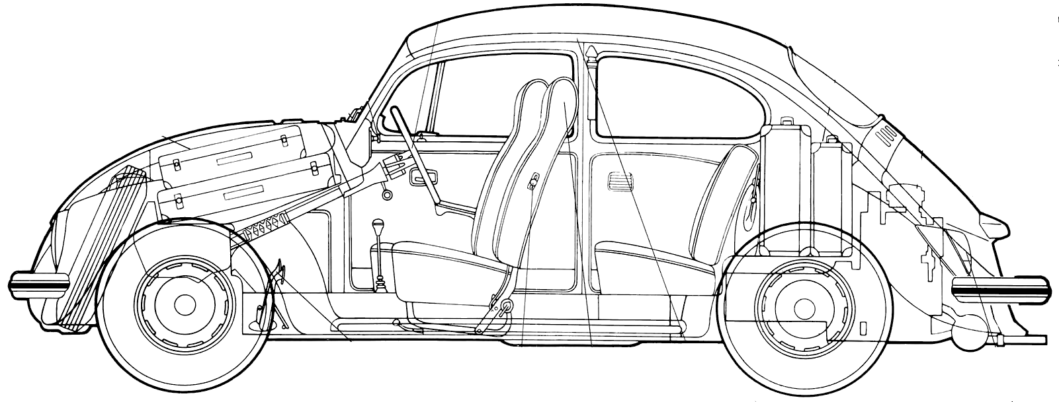
OOP Foundations
class Car(object):
"""Blueprint for a virtual car"""
def __init__(self, name):
self.miles = 0
self.name = name
def speak(self, text):
print self.name, ":", text
#main
kitt = Car("Kitt")
kitt.speak("Hi")
kitt.miles = 100
print kitt.miles
Class definition & docstring
Constructor, with attributes
Class method
Instantiated object
Calling a method
Changing the value of an instance’s attribute

Slide 3
OOP – To String Method
class Car(object):
""" Blueprint for a virtual car """
def __init__(self, name):
self.miles = 0
self.name = name
def __str__(self): #defines how the object will convert
reply = "Car object\n"
reply += "Name: " + self.name + "\n"
reply += "Mileage: " + str(self.miles) + "\n"
return reply
def speak(self, text):
print self.name, ":", text
“to string” method

Slide 4
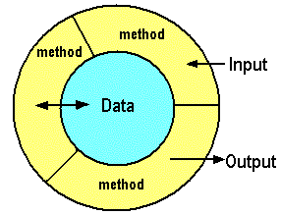
OOP & Encapsulation
While we can work with attributes directly, using object.attribute, we often want to provide some protection on those attributes.
Should a program just be able to set an attribute’s value to anything?
Should something special happen when a value is changed, or should another value also change?
For validation and data protection, we use encapsulation! We write methods to manage access to data.

Slide 5
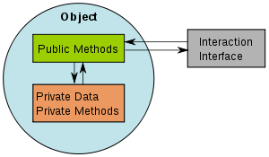
OOP & Encapsulation
Public methods and data can be accessed directly and changed by anyone.
Private methods and data can be accessed directly within a specific instance of the class, but must be indirectly accessed outside of the object.

Slide 6
OOP & Private Attributes
#main
herby = Car("Herby")
print herby.name #error!
print herby.__name #error!
herby.__name = "Test " #doesn’t work!
Two underscores in front of the name of a method or attribute mark it as private. All other methods and attributes are public.
Trying to change a private variable outside of the class will cause an error.
RL Note: In a real project, by default, all attributes should be private. You must justify making something public!
class Car(object):
"""Blueprint for a virtual car"""
def __init__(self, name):
self.miles = 0
self.__name = name
Car.count += 1
def __str__(self):
reply = "Car object\n"
reply += "Name: " + self.__name + "\n"
reply += "Mileage: " + str(self.miles) + "\n"
return reply

Slide 7
OOP & Read Properties
Restoring read to a private attribute:
@property #decorator
def name(self):
return self.__name
print herby.name #note, no underscores!

Slide 8
OOP & Write Setters
Restoring write to a private attribute:
@name.setter #decorator, use this format.
def name(self, new_name):
if new_name == "":
print "A talking car needs a name!"
else:
self.__name = new_name
print "Name change successful."

Slide 9
OOP & Encapsulation
class Car(object):
"""A blueprint for a virtual car"""
count = 0
@staticmethod
def inventory():
print "\nThere are", Car.count, "cars."
def __init__(self, name):
self.miles = 0
self.__name = name
Car.count += 1
@property
def name(self):
return self.__name
@name.setter
def name(self, new_name):
if new_name == "":
print "A talking car needs a name!"
else:
self.__name = new_name
print "Name change successful."
def __str__(self):
reply = "Car object\n"
reply += "Name: " + self.__name + "\n"
reply += "Mileage: " + str(self.miles) + "\n"
return reply
def speak(self, text):
print text
#main
kitt = Car("Kitt")
herby = Car("Herby")
print kitt
herby.name = ""
herby.name = "New Bug"
print herby
Car.inventory()
The user doesn’t need to know/call any method names for our code to run!

Slide 10
Class Attributes and Static Methods
class Car(object):
"""A virtual car"""
count = 0 #class attribute!
@staticmethod
def inventory():
print "\nThere are", Car.count, "cars."
def __init__(self, name):
self.miles = 0
self.name = name
Car.count += 1
#main
kitt = Car("Kitt")
herby = Car("Herby")
Car.inventory()
@staticmethod is a decorator that tells Python that the method is a static method shared by the entire class.
Static methods don’t take self as an argument – they don’t belong to an instance!
Class attributes and static methods use dot notation, but they use the name of the class, not the name of the instance!

Slide 11
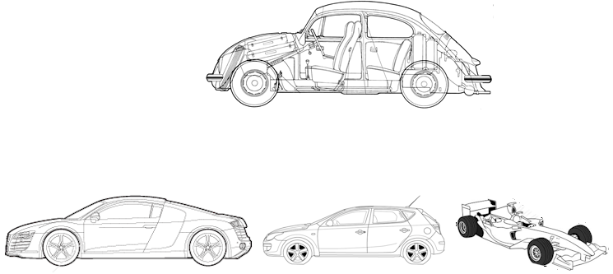
Working with Multiple Classes
Inheritance!
Derive new classes from existing ones
Extend the definition of existing classes
Override method definitions of existing classes

Slide 12
Inheritance Example
class Animal(object):
def __init__(self, name, age): # Constructor
self.name = name
self.age = age
class Cat(Animal):
def speak(self):
return 'Meow!'
class Dog(Animal):
def speak(self):
return 'Woof! Woof!'
animals = [Cat('Mist', 8), Cat('Jack', 3), Dog('Kahlua', 7)]
for animal in animals:
print animal.speak() + ' My name is ' + animal.name + '. ',
print 'I am', animal.age, 'years old.'
Animal is the parent/base class
Cat and Dog are child/derived classes
Notice code from the parent class is still usable in child classes.

Slide 13
Overriding Example
class Animal(object):
def __init__(self, name):
self.name = name
def talk(self):
return 'Hello!'
class Cat(Animal):
def talk(self):
return 'Meow!'
animals = [Animal("Chupacabra"), Cat("Mist")]
for critter in animals:
print critter.talk()
Cat overrides the definition of talk()!!

Slide 14
Overload Example: __cmp__
class Animal(object):
def __init__(self, name, age):
self.name = name
self.age = age
def __cmp__(self, other):
#overloads general comparisons
if self.age > other.age:
return 1 # positive int means greater
elif self.age == other.age:
return 0 # zero means equal
elif self.age < other.age:
return -1 # negative int means smaller
print Animal('Mist', 6) < Animal('Jack', 2)
print Animal('Spot', 5) == Animal('Rex', 5)

Slide 15
Super Function Example
class Animal(object):
def __init__(self, name):
self.name = name
self.age = 0
self.hunger = 0
class Cat(Animal):
def __init__(self, name, breed):
super(Cat, self).__init__(name)
self.breed = breed
cat1 = Cat("Mist", "Tabby")
print cat1.name, "is a", cat1.breed
Cat calls its parent class’s version first!

Slide 16

Communication Example
import random
class Player(object):
def __init__(self, name):
self.name = name
def attack(self, target, chance):
if random.randrange(1,101) <= chance:
print self.name, "hits!"
target.die()
else:
print self.name, "missed!"
class Enemy(object):
def __init__(self, name):
self.name = name
self.alive = True
def die(self):
print self.name, "stomped! X_X"
self.alive = False
#main
mario = Player("Mario")
koopa = Enemy("Koopa")
while koopa.alive:
mario.attack(koopa, 33)
>>>
Mario missed!
Mario missed!
Mario hits!
Koopa stomped! X_X

Slide 17
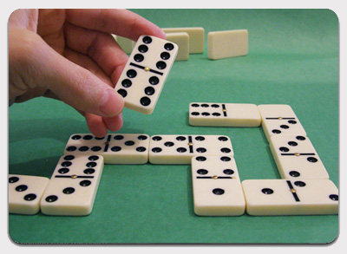
Dominoes (Group Work)
Dominoes can only be connected if their ends have a matching number:
>>>
Current chain: None
Available dominoes: 0 - |2:3| 1 - |6:4| 2 - |1:3| 3 - |4:1|
Attempting to add domino 0 to the chain.
|2:3| added to the current chain!
Current chain: |2:3|
Available dominoes: 0 - |6:4| 1 - |1:3| 2 - |4:1|
Attempting to add domino 1 to the chain.
|3:1| added to the current chain!
Current chain: |2:3||3:1|
Available dominoes: 0 - |6:4| 1 - |4:1|
Attempting to add domino 0 to the chain.
|6:4| doesn't fit on the current chain!
Current chain: |2:3||3:1|
Available dominoes: 0 - |6:4| 1 - |4:1|
Attempting to add domino 1 to the chain.
|1:4| added to the current chain!
Current chain: |2:3||3:1||1:4|
Available dominoes: 0 - |6:4|
Attempting to add domino 0 to the chain.
|4:6| added to the current chain!
Current chain: |2:3||3:1||1:4||4:6|
Available dominoes: None
Write 2 Classes, Domino and Chain, to simulate this! Starter code on Oncourse as domino_starter.py

Slide 18
Dominoes (Solution)
class Domino(object):
def __init__(self, head, tail):
self.head = head
self.tail = tail
def __str__(self):
return "|" + str(self.head) + ":" + str(self.tail) + "|"
def flip(self):
self.head, self.tail = self.tail, self.head
def fits(self, other):
if other.tail == self.head:
return True
elif other.tail == self.tail:
self.flip()
return True
else:
return False

Slide 19
Dominoes (Solution)
class Chain(object):
def __init__(self):
self.dominoes = []
self.chain = []
def __str__(self):
reply = "Current chain: "
if not self.chain:
reply += "None"
else:
for domino in self.chain:
reply += str(domino)
reply += "\nAvailable dominoes:\t"
if not self.dominoes:
reply += "None"
else:
for i in range(len(self.dominoes)):
reply += str(i) + " - " + str(self.dominoes[i]) + "\t"
return reply + "\n"
def add(self, domino):
self.dominoes.append(domino)
def play(self, num):
print "Attempting to add domino", num, "to the chain."
if not self.chain or self.dominoes[num].fits(self.chain[-1]):
print self.dominoes[num], "added to the current chain!"
self.chain.append(self.dominoes.pop(num))
else:
print self.dominoes[num], "doesn't fit on the current chain!"
def moves(self, num_list):
for num in num_list:
print self
self.play(num)
#main
my_chain = Chain()
my_chain.add(Domino(2,3))
my_chain.add(Domino(6,4))
my_chain.add(Domino(1,3))
my_chain.add(Domino(4,1))
my_chain.moves([0,1,0,1,0])
print my_chain

Slide 20
A Few Shortcuts
Summing up a list of numbers:
numbers = [0,1,2,3,4,5]
Old:
total = 0
for num in numbers:
total += num
print total
Better:
print sum(numbers)

Slide 21
A Few Shortcuts
Concatenating a list of strings:
words = ["This", "is", "Sparta!"]
Old:
sentence = ""
for word in words:
sentence += word + " "
print sentence
Better:
print " ".join(words)

Slide 22
A Few Shortcuts
Creating a dictionary to count things:
nums = [0,1,2,3,2,1,1,0,0,1,2]
Old:
counts = {}
for num in nums:
if num in counts:
counts[num] += 1
else:
counts[num] = 1
print counts
Better:
counts = {}
for num in nums:
counts[num] = counts.get(num, 0) + 1
print counts

Slide 23
Set Builder Notation (I201)
Set builder notation is an unambiguous way to define a set:
A = {2x | x∈ ℤ and 0 < x < 5}
B = {x | x∈ ℤ, 0 < x < 20, and x is even}
A - B = {x | x ∈A ∧ x ∉ B}
A X B = {(a, b) | a ∈A ∧ b ∈B}
Python has this syntax also! Using list comprehensions, we can quickly define a complex list!

Slide 24
List Comprehensions
A = {2x | x∈ ℤ and 0 < x < 5}
To create this set as a list, we could do this:
set_a = []
for i in range(1,5):
set_a.append(2 * i)
Or we could use a list comprehension:
set_a = [2*i for i in range(1,5)]

Slide 25
List Comprehensions
We can turn any situation in which we’d write:
some_list = []
for item in sequence:
some_list.append(<pattern based on item>)
into:
some_list = [<pattern based on item> for item in sequence]

Slide 26
List Comprehensions
B = {x | x∈ ℤ, 0 < x < 20, and x is even}
To create this set as a list, we would write:
set_b = []
for i in range(1,20):
if i % 2 == 0:
set_b.append(i)
Or we could write:
set_b = [i for i in range(1,20) if i % 2 == 0]

Slide 27
List Comprehensions
A - B = {x | x ∈A ∧ x ∉ B}
set_a = [0,1,2,3,4,5,6]
set_b = [2,5]
To create A - B as a list, we could do this:
a_minus_b = []
for num in set_a:
if num not in set_b:
a_minus_b.append(num)
Or we could use a list comprehension:
a_minus_b = [num for num in set_a if num not in set_b]

Slide 28
List Comprehensions
We can turn any situation in which we’d write:
some_list = []
for item in sequence:
if <boolean expression>:
some_list.append(<item pattern>)
into:
some_list = [<item pattern> for item in sequence if <boolean expression>]

Slide 29
List Comprehensions
If we already have a list, it’s even easier!
numbers = [0,1,2,3,4,5,6,7,8,9]
Applying a transformation (multiply by 3) to an entire list:
for i in range(len(numbers)):
numbers[i] *= 3
List comprehension:
numbers = [num * 3 for num in numbers]

Slide 30
List Comprehensions
If we already have a list, it’s even easier!
letters = ['a','b','c','d','e']
Applying a filter (upper case) to the entire list:
for i in range(len(letters)):
letters[i] = letters[i].upper()
List comprehension:
letters = [char.upper() for char in letters]

Slide 31
List Comprehensions
If we already have a list, it’s even easier!
numbers = [0,1,2,3,4,5,6,7,8,9]
Applying a filter (divisible by 3) to the entire list:
numbers_div_3 = []
for num in numbers:
if num % 3 == 0:
numbers_div_3.append(num)
numbers = numbers_div_3
List comprehension:
numbers = [num for num in numbers if num % 3 == 0]

Slide 32
Divisible By (Group Work)
Use list comprehensions to mimic this exchange: (Don’t forget to validate your int conversions!)
>>>
Please enter a lower bound (int): cat
That's not an integer.
Please enter a lower bound (int): 0
Please enter an upper bound (int): 50
All of the even numbers between 0 and 50 : [0, 2, 4, 6, 8, 10, 12, 14, 16, 18, 20, 22, 24, 26, 28, 30, 32, 34, 36, 38, 40, 42, 44, 46, 48, 50]
Please enter a number to divide by (int): 7
All of the even numbers between 0 and 50 that are divisible by 7 : [0, 14, 28, 42]

Slide 33
Divisible By (Solution)
def valid_int(description): #we are going to do this a lot, so use a function
while True:
try:
valid = int(raw_input("Please enter " + description + " (int): "))
except:
print "That's not an integer."
else:
return valid
lower = valid_int("a lower bound")
upper = valid_int("an upper bound")
print "All of the even numbers between", lower, "and", upper, ": ",
print [2*i for i in range(lower, upper/2+1)]
factor = valid_int("a number to divide by")
print "All of the even numbers between", lower, "and", upper, "that are divisible by", factor, ":",
print [2*i for i in range(lower, upper/2+1) if 2*i % factor == 0]

Slide 34
Questions?

